Slide 1
Microsoft TEAMs for those just beginning: What you need to know to be ready for your students
Yonkers Public Schools 2020-2021

Slide 2
This Presentation includes:
How to Find Microsoft Teams
How to create a Welcome Message for your students
How to invite your students to the class by scheduling a meeting
How to upload files and create assignments
How to use the video and chat functions
Other functions of Teams

Slide 3
It is easy to find your Microsoft Class Team
See the following examples

Slide 4
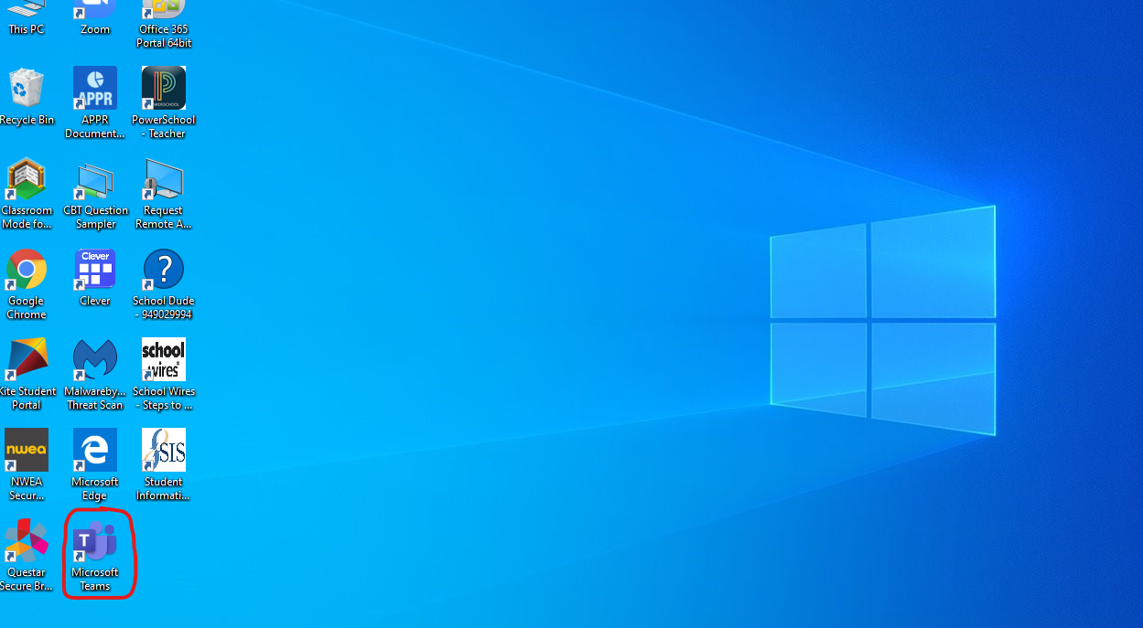
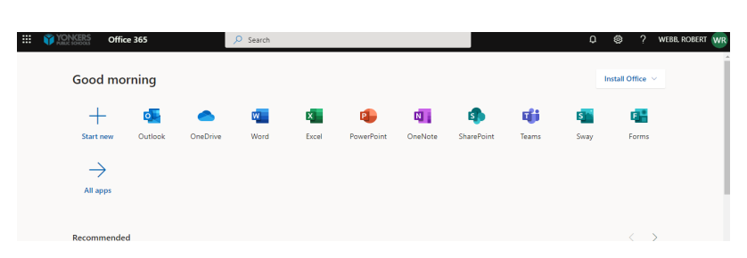
Where to find Teams
1. On your “District Device”
The Microsoft Teams App has been installed on all school devices on the home page.
2. On the web
https://www.office.com

Slide 5
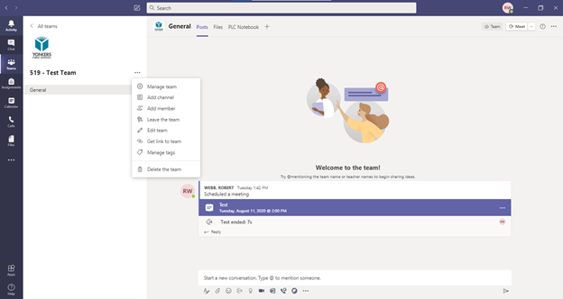
How to create a Welcome message for your Students

Slide 6
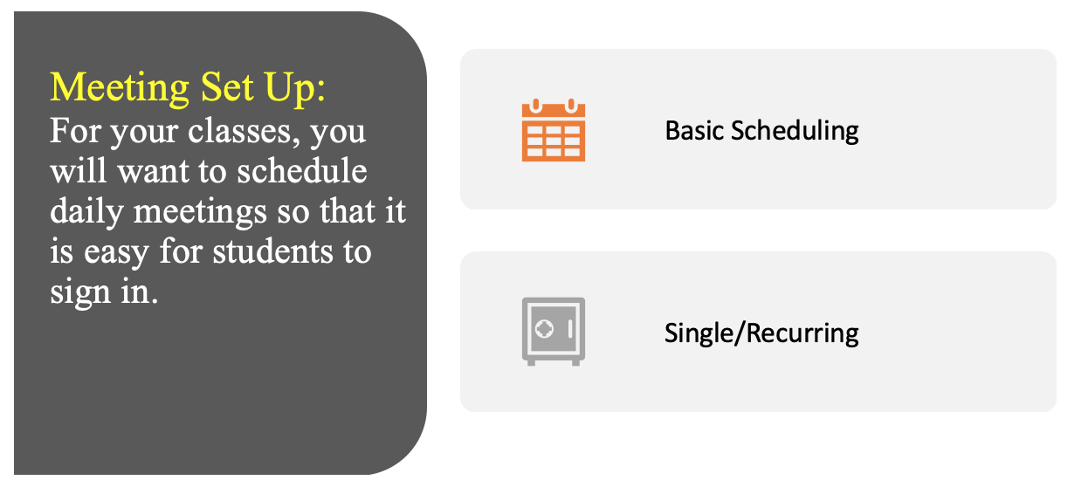
Invite your students to your class by scheduling a meeting

Slide 7
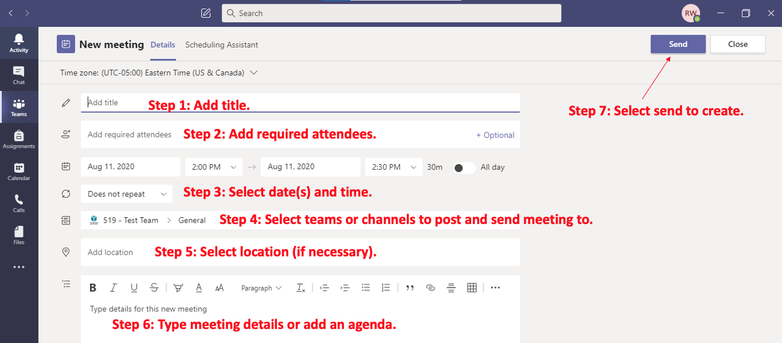
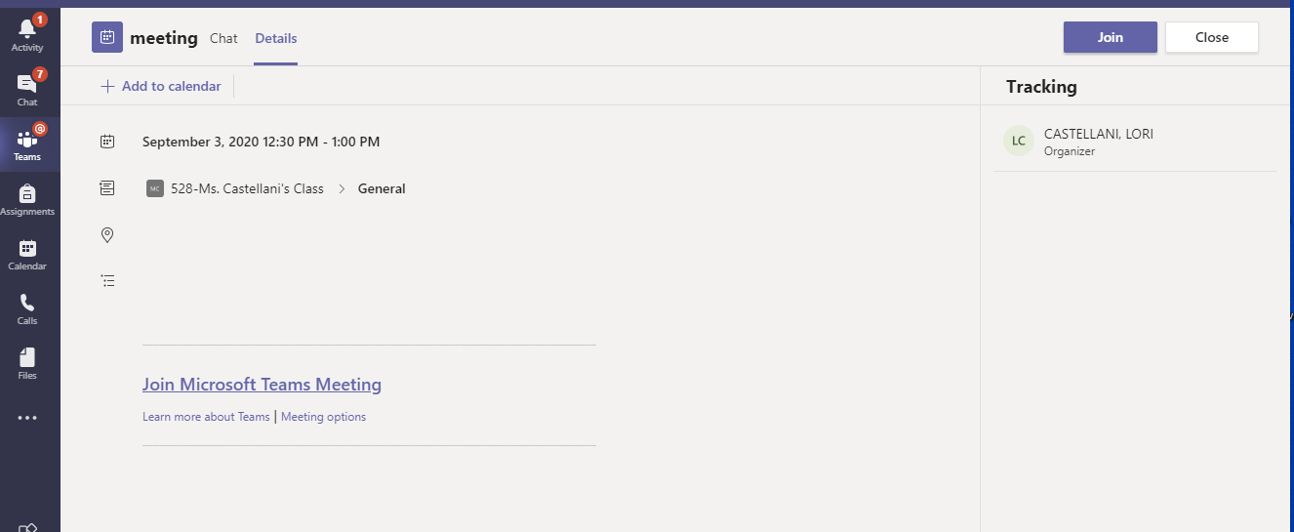
Scheduling a team meeting continued…
“Join Microsoft Team Meeting” Copy and Paste this to your Teacher Webpage for easy student sign ins.

Slide 8
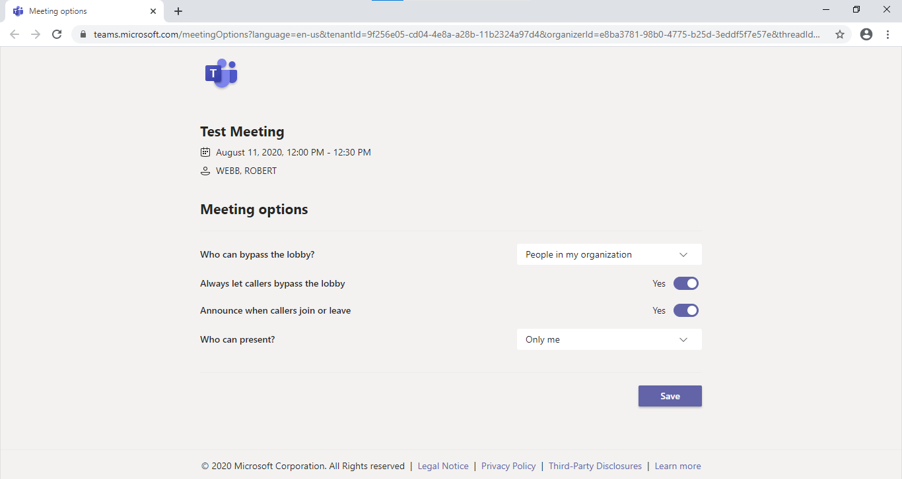
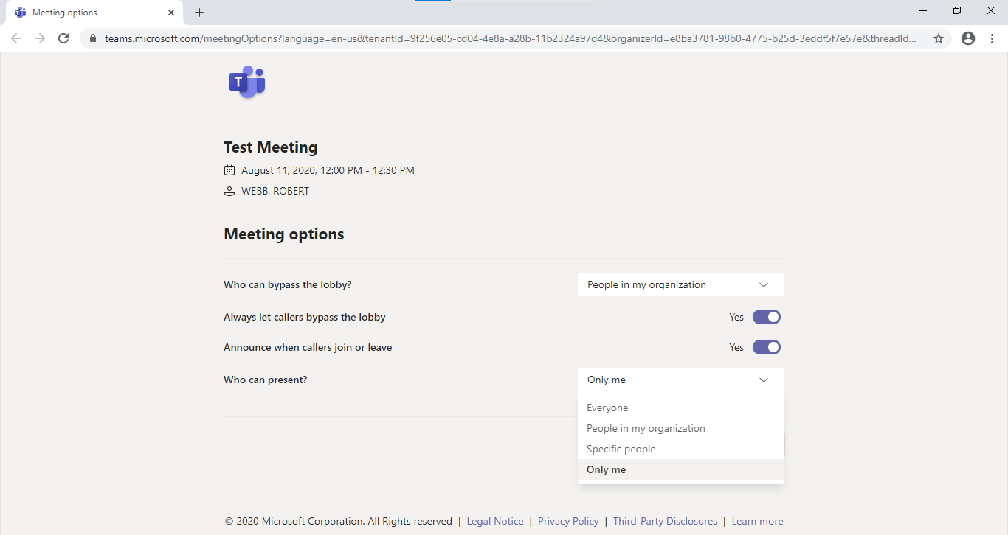
Meeting Set Up: Meeting Options IMPORTANT!
Select "only me" to prevent other participants from sharing, removing participants, muting others and recording.

Slide 9
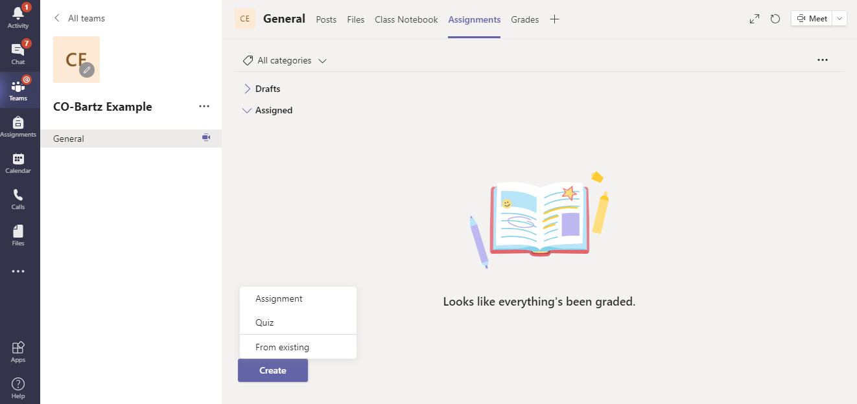
How to Create an Assignment

Slide 10
Creating Class Assignments
Select the Assignments tab at the top of the home page.
You can also navigate to the “Teams” tab on the left side if you want to create an assignment in other Teams that you have created.
Assignments Tab
Select Teams to show all of your "teams"/classes.

Slide 11
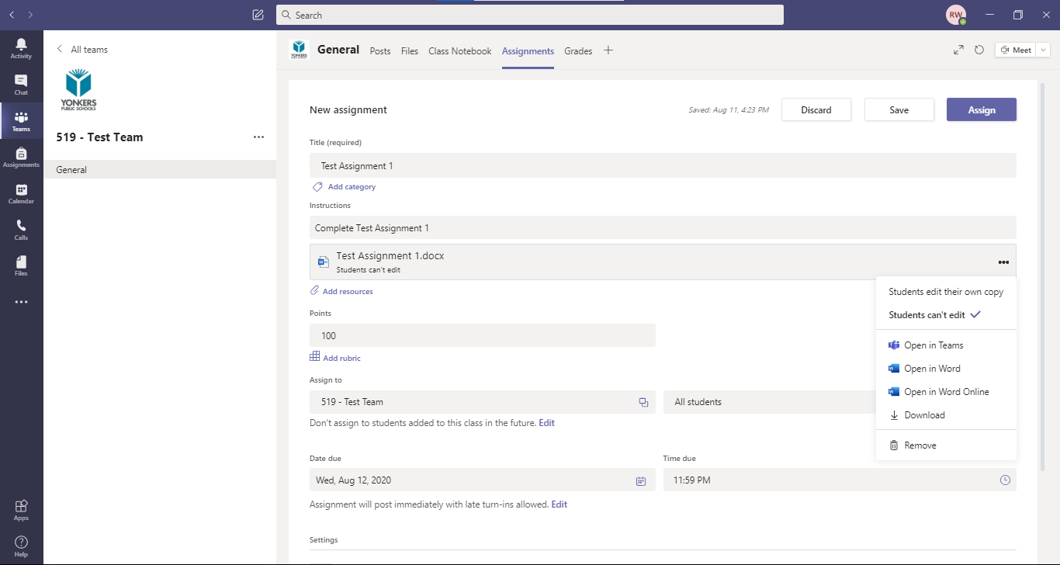
Creating Class Assignments
Step 1: Add a title
Step 2: Add instructions
Step 7: Select assign
Step 3: Add resources (worksheets, videos, links and more).
Step 4: Add and create rubrics and assignment point value.
Step 5: Select one or more classes to assign the assignment.
Step 6: Select an assign time and date as well as a due and close date.

Slide 12
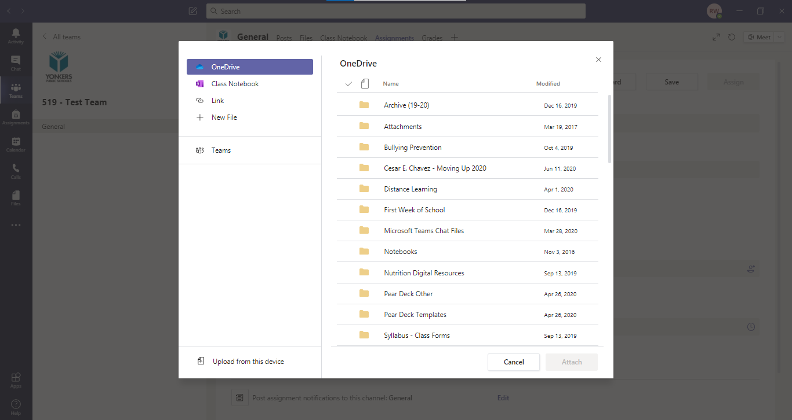
Select resources from OneDrive, Notebook (OneNote), Links, or upload from the current device.
Schedule to assign in the future or right now. Select a due date and when the assignment will close.

Slide 13
Class Management Features in Microsoft Teams
A Closer Look

Slide 14
Important Features Within Teams Meeting
Mute all students
Blur/Virtual Background
Attendance
Call student
Raise Hand/Class Management Functions
Share Screen (with and without audio)
For class management techniques, you can teach students how to use the "Raise Hand" feature. While you are speaking in class, you may wish to The"Mute all students." "Share Screen" feature allows you to show presentations, for instance a PowerPoint or a short video. Students may ask a question using the “Chat” feature. Each of these features is further explained within the videos posted in Clever and the YPS Distance Learning Website.
Utilize Chat within Video Meeting
Disable student recording/muting ability

Slide 15
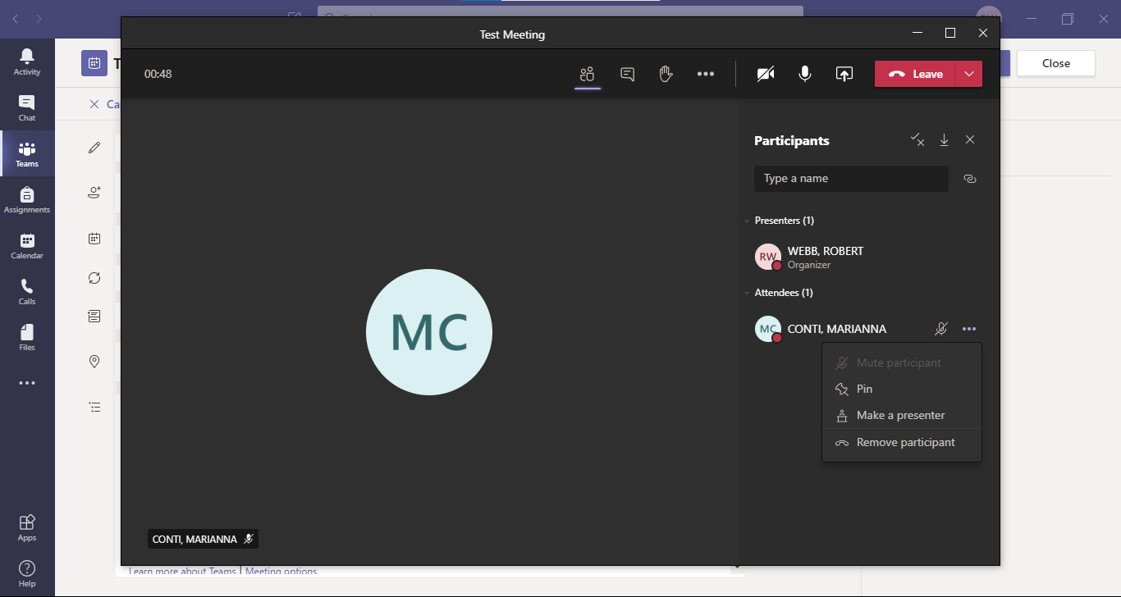
How to Mute Participants
Step 1: Select the Show Participants icon
Step2: Select the three dots - Mute participant

Slide 16
Taking Attendance: This feature can be used when you are "live" with students.
Step 1: Select the Show Participants icon
Step2: Select download attendance list

Slide 17
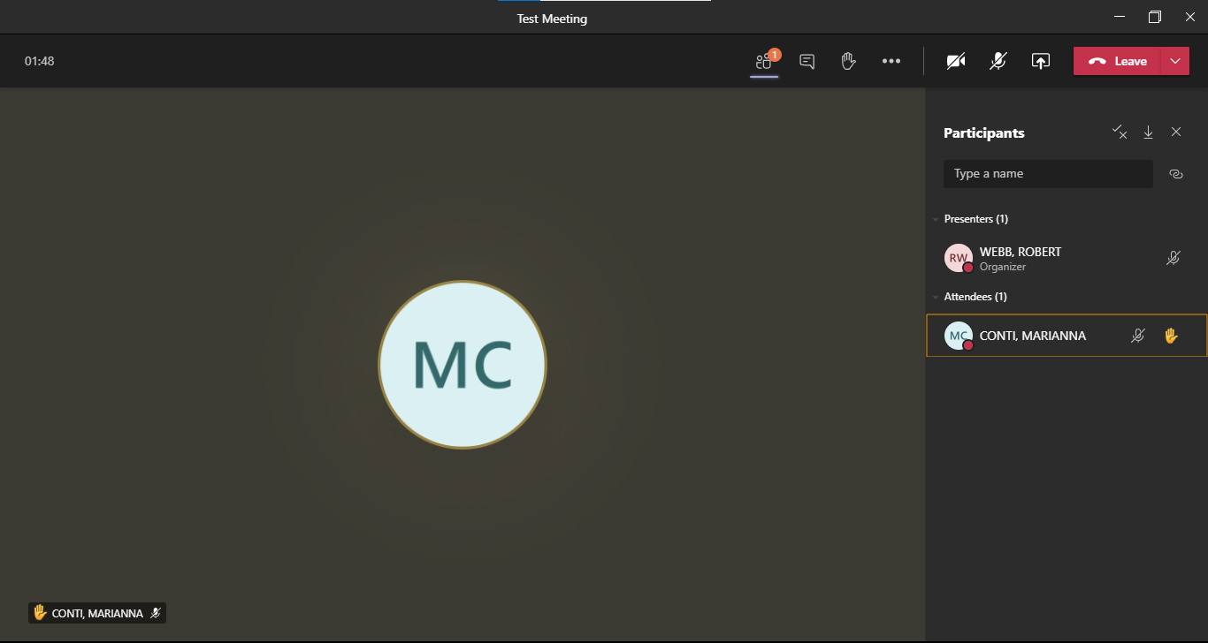
The Hand Raise feature
Show Participants icon highlights notification
How to raise hand – Select icon
Show Participants list will show attendee with hand raised

Slide 18
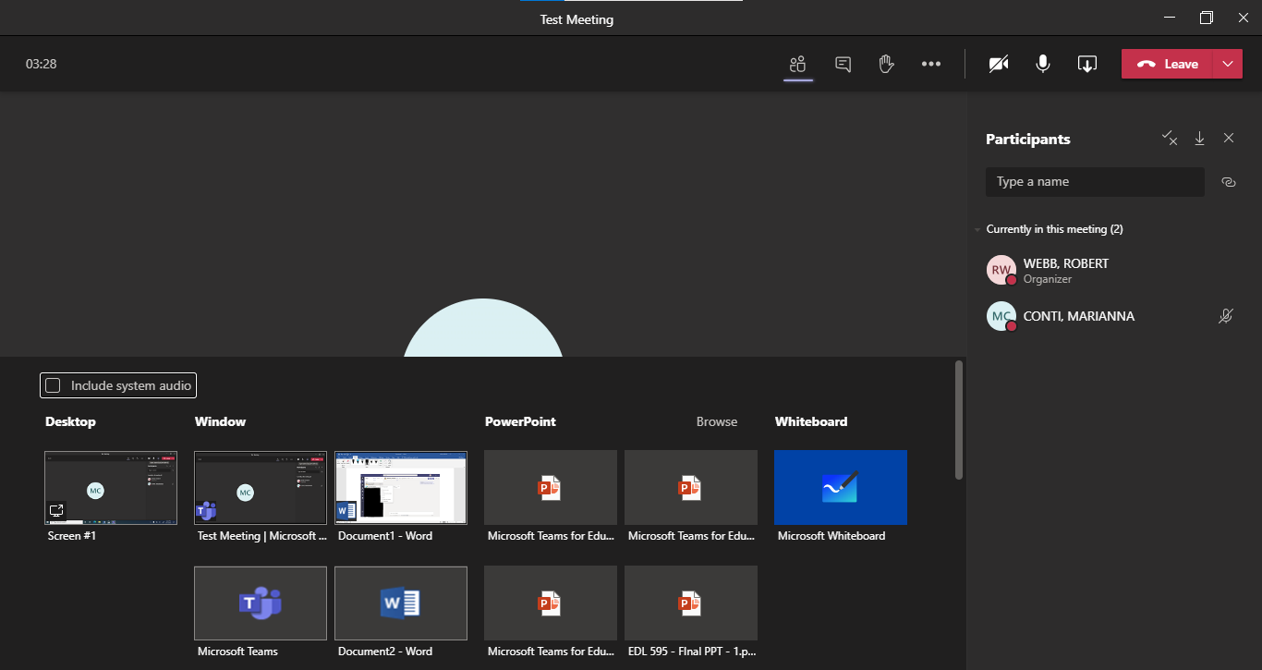
Screen Share
Step 1: Select Share Screen Icon
Step 2: Select Screen to Share
Must select if sharing a video or presentation that includes sound.
Whiteboard Option

Slide 19
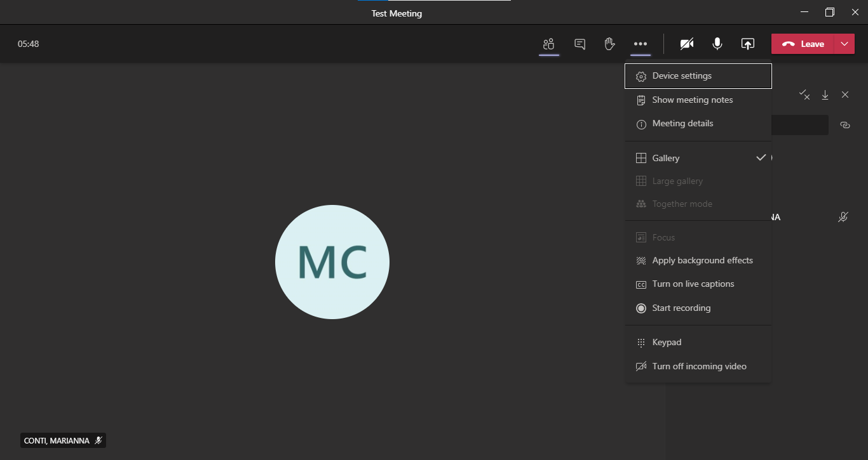
Other settings, including how to teach students to blur their backgrounds, are located within the toolbar (three dots).
Select the three dots for options including device settings, background effects (virtual/blur background), meeting recording and more.

